Slide 1
Summary of MC test

Slide 2
Background
Betty wants to compare ImQMD/pBUU events with real event in the future, and MC needs to be realistic
In preparation for this eventuality, I have started to simulate the entire ImQMD event and check for any signs of problems (quite a few)
Caution: ImQMD is not calibrated for physics extraction!
Multiplicity of ImQMD ~ 130
Angular distribution of ImQMD favors forward angle more strongly than data.
In short, ImQMD only serve as a bug fixing tools in this study.

Slide 3
Configuration
Space charge with charge density = 4e-8 C/m2 is used in MC and reco task.
Drift velocity = 5.515 cm/us

Slide 4
Section I: PID

Slide 5
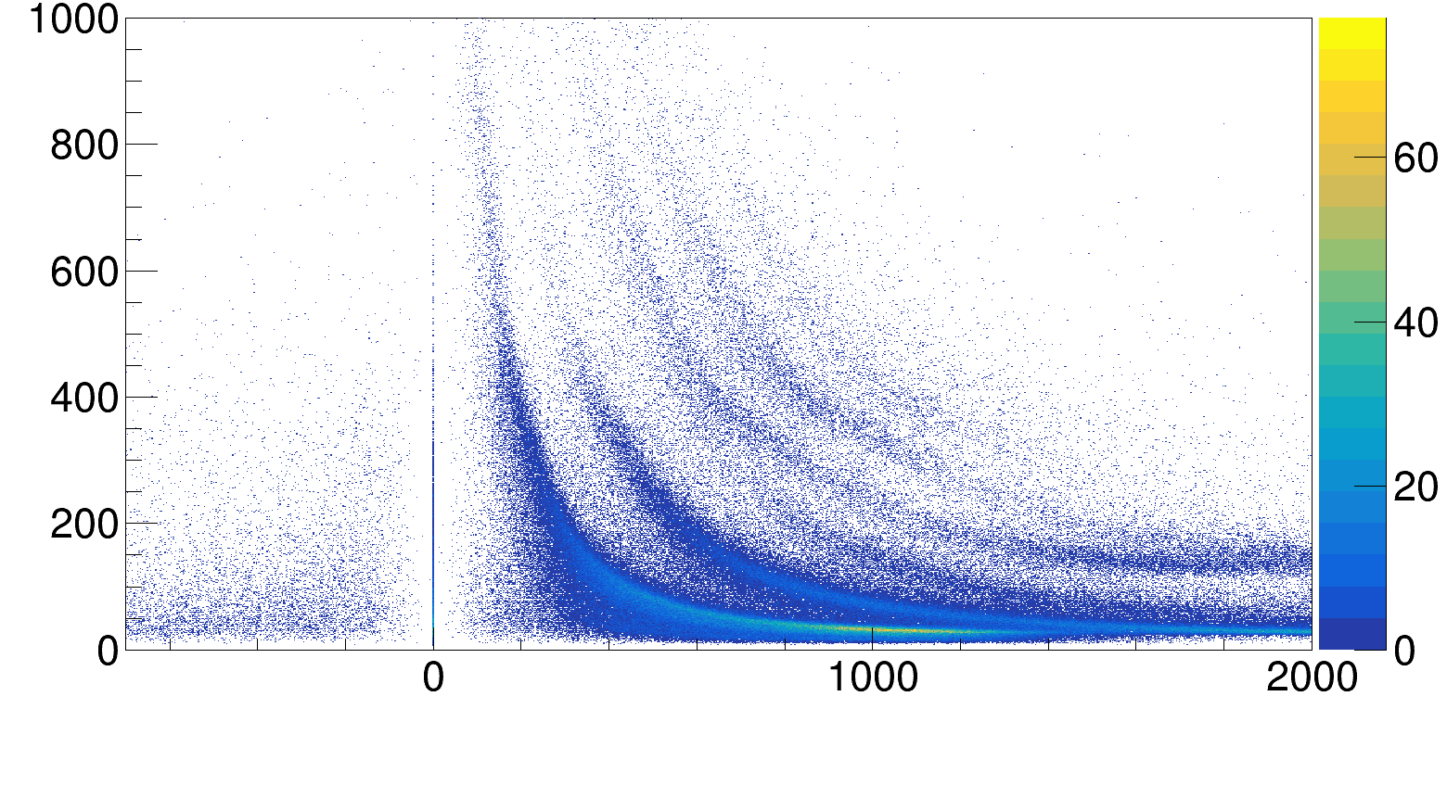
Original Spirit root (0a2fdaa, 20th Sep)
Particle PID when the entire ImQMD events is supplied into SpiRIT ROOT
dE/dx
Momentum MeV/c

Slide 6
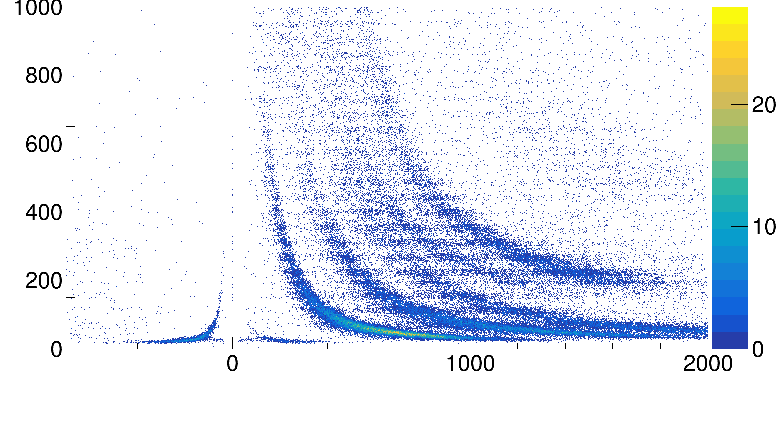
Data PID
dE/dx
Momentum MeV/c

Slide 7
Comparison between the two
Data
dE/dx
Momentum MeV/c

Slide 8
MC
dE/dx
Momentum MeV/c

Slide 9
Clearly something’s wrong with MC dEdx calculation
MC
dE/dx
Momentum MeV/c

Slide 10
What I and Justin discovered
It disproportionally affect high dEdx values
It is where Justin’s correction class kicks in
For Justin’s correction class to work, it needs to know which hits are saturated in order to correct for it, and some saturated MC hits are not classified correctly…

Slide 11
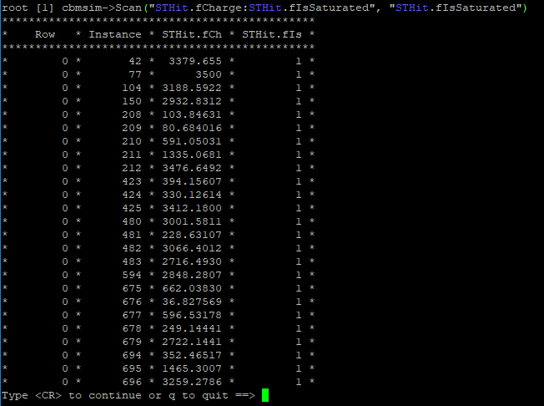
Saturation threshold is 3500

Slide 12
How was saturated pulse created
Kenako-san’s saturated pulse MC pulse before saturation
Saturation threshold

Slide 13
How was saturated pulse created
Kenako-san’s saturated pulse Resultant MC pulse
0
Saturation threshold
0
The program reuse the rising edge of the original pulse!

Slide 14
Solution
Use the raising edge of the saturated pulse as well
Just use the entire Kenako san’s pulse

Slide 15
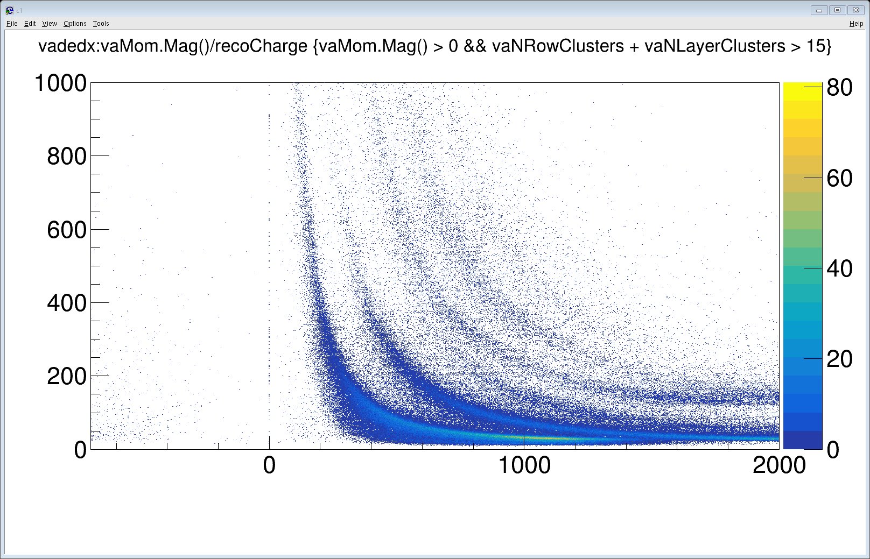
Particle PID after the pulse modification
dE/dx
Momentum MeV/c

Slide 16
Particle PID after the pulse modification
dE/dx
Momentum MeV/c

Slide 17
Section II: Angular coverage

Slide 18
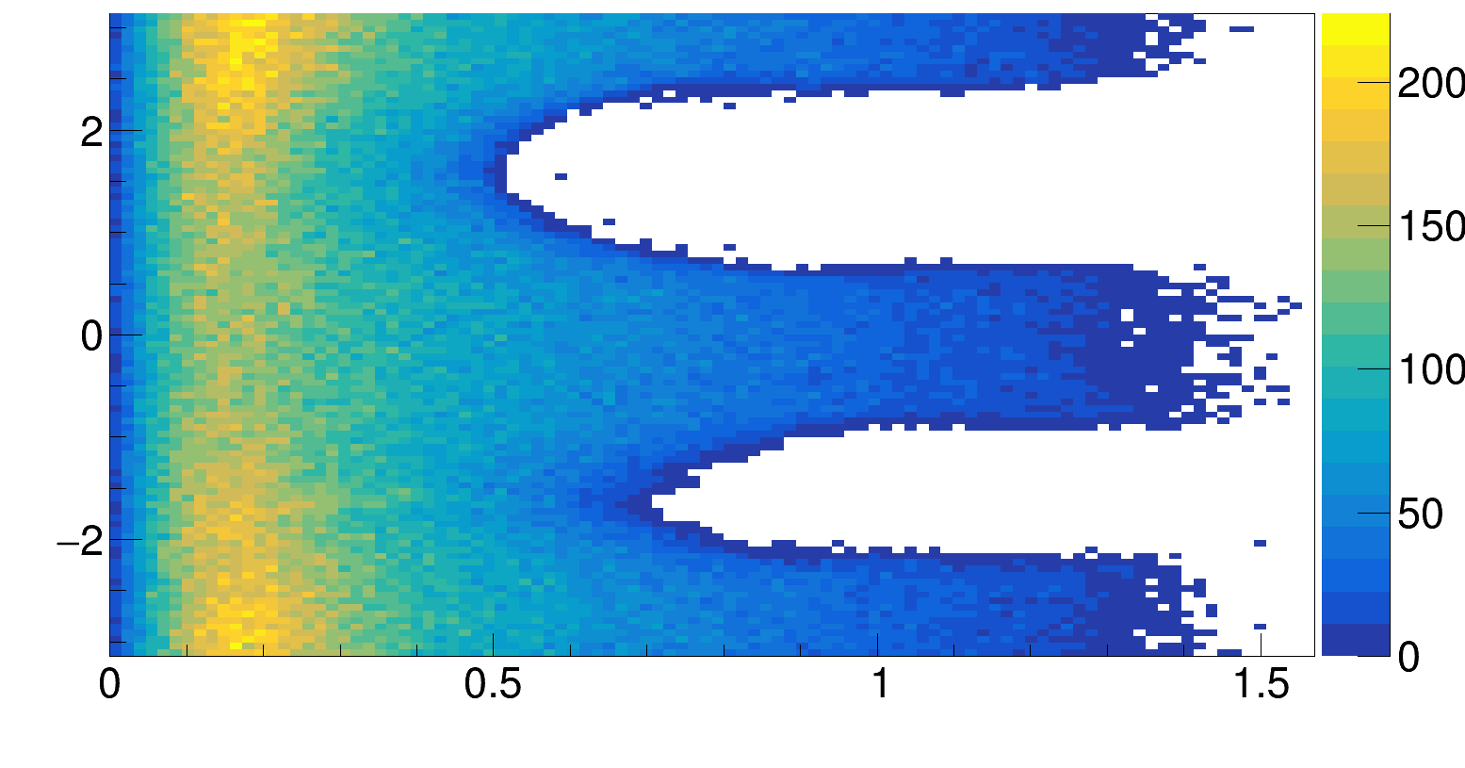
Original SpiRIT ROOT (number of clusters > 15)
Phi (rad)
Theta (rad)

Slide 19
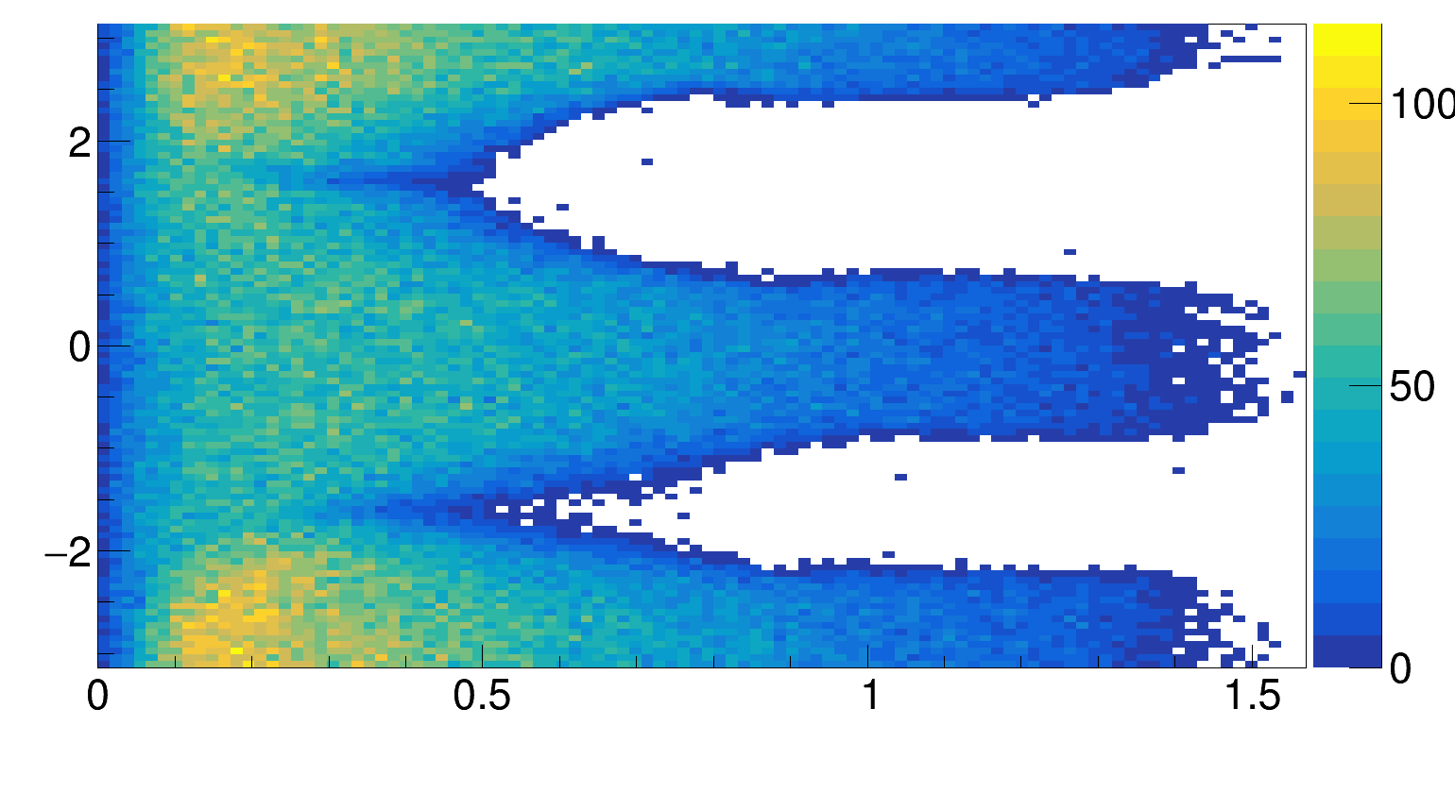
Data
Phi (rad)
Theta (rad)

Slide 20
Data
Something happens at phi = +/- 90 deg…
Phi (rad)
Theta (rad)

Slide 21
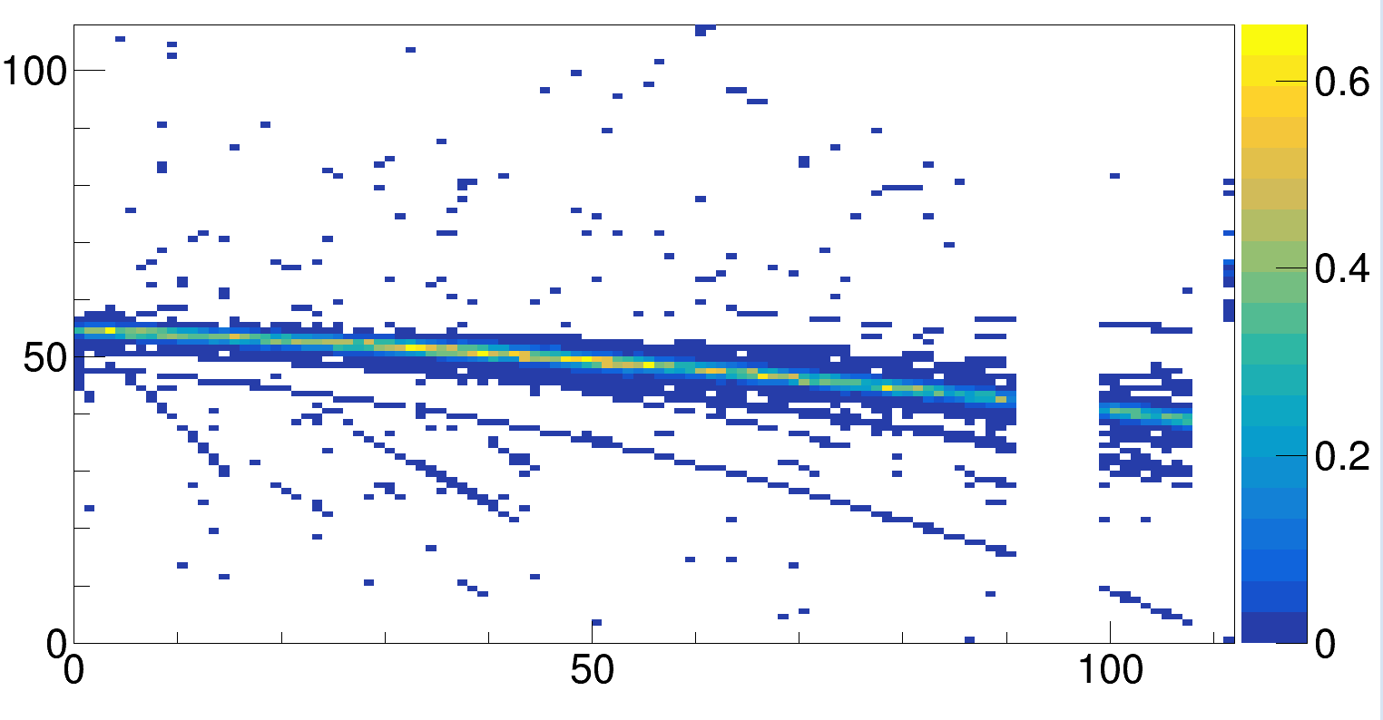
Pads on the beam has to be dead
Count the number of pads that are completely dead in a real event
Create a probability distribution of when pads are dead
Row
Layer

Slide 22
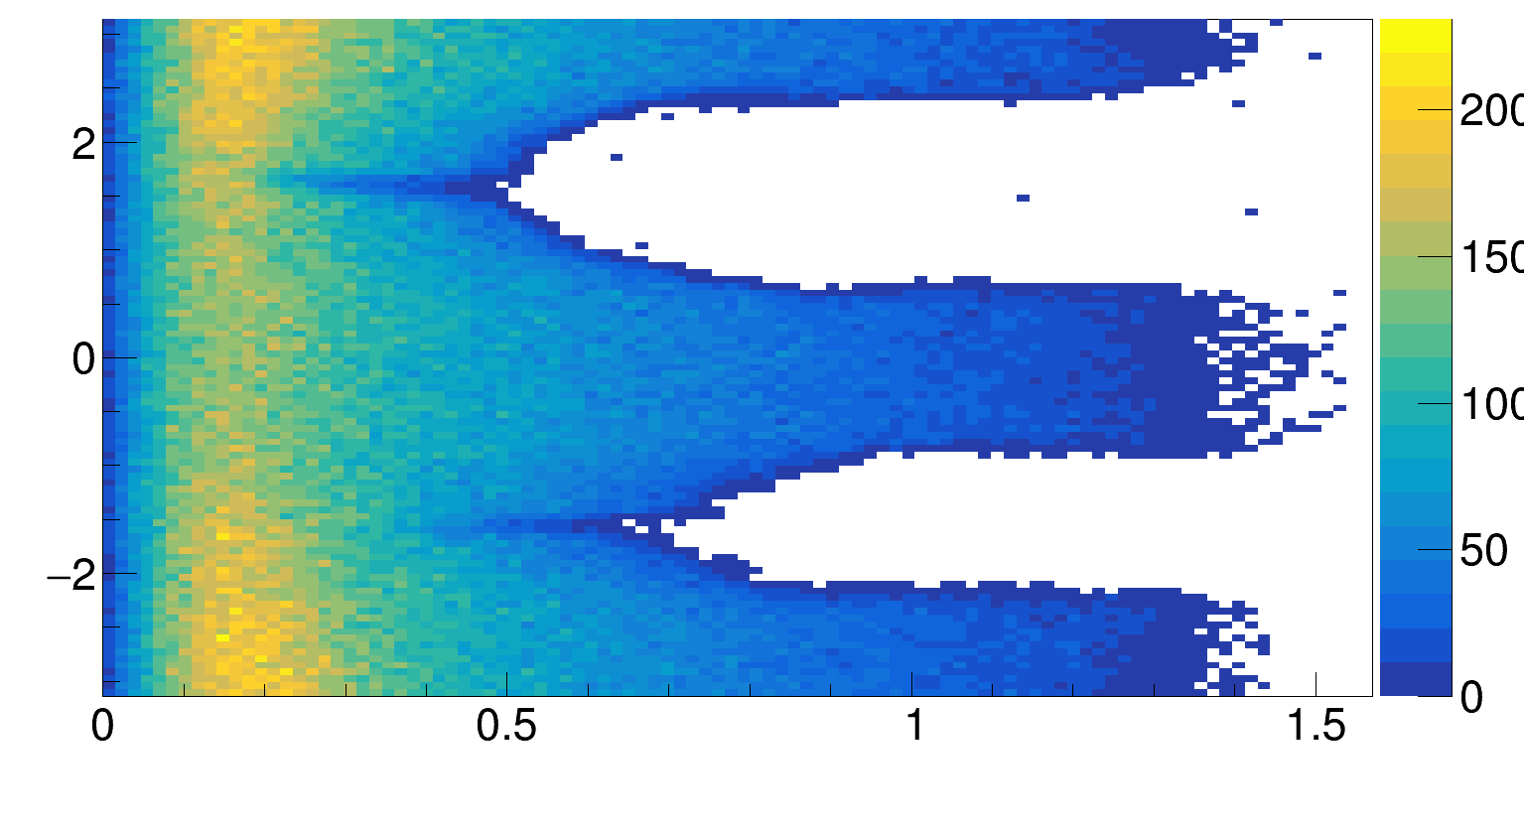
With dead pad on beam

Slide 23
Data
Phi (rad)
The tough at phi = -90 deg is still not good…
Theta (rad)

Slide 24
Data
Phi (rad)
The tough at phi = -90 deg is still not good…
Theta (rad)

Slide 25
With dead pad on beam

Slide 26
On possible reason: Additional pads are dead at (not on) beam?
Is it possible that some pads are not dead from the very beginning, but are dead only when electrons from the beam arrives?
This is less precise, but here’s my attempt in creating a probability map for such possibilities.
For up-stream events, plot the distribution of pads that are saturated at time-bucket 100 – 130
Divide the distribution by total number of up-stream events to get probability distribution
Kill that pad after beam height using the said distribution

Slide 27
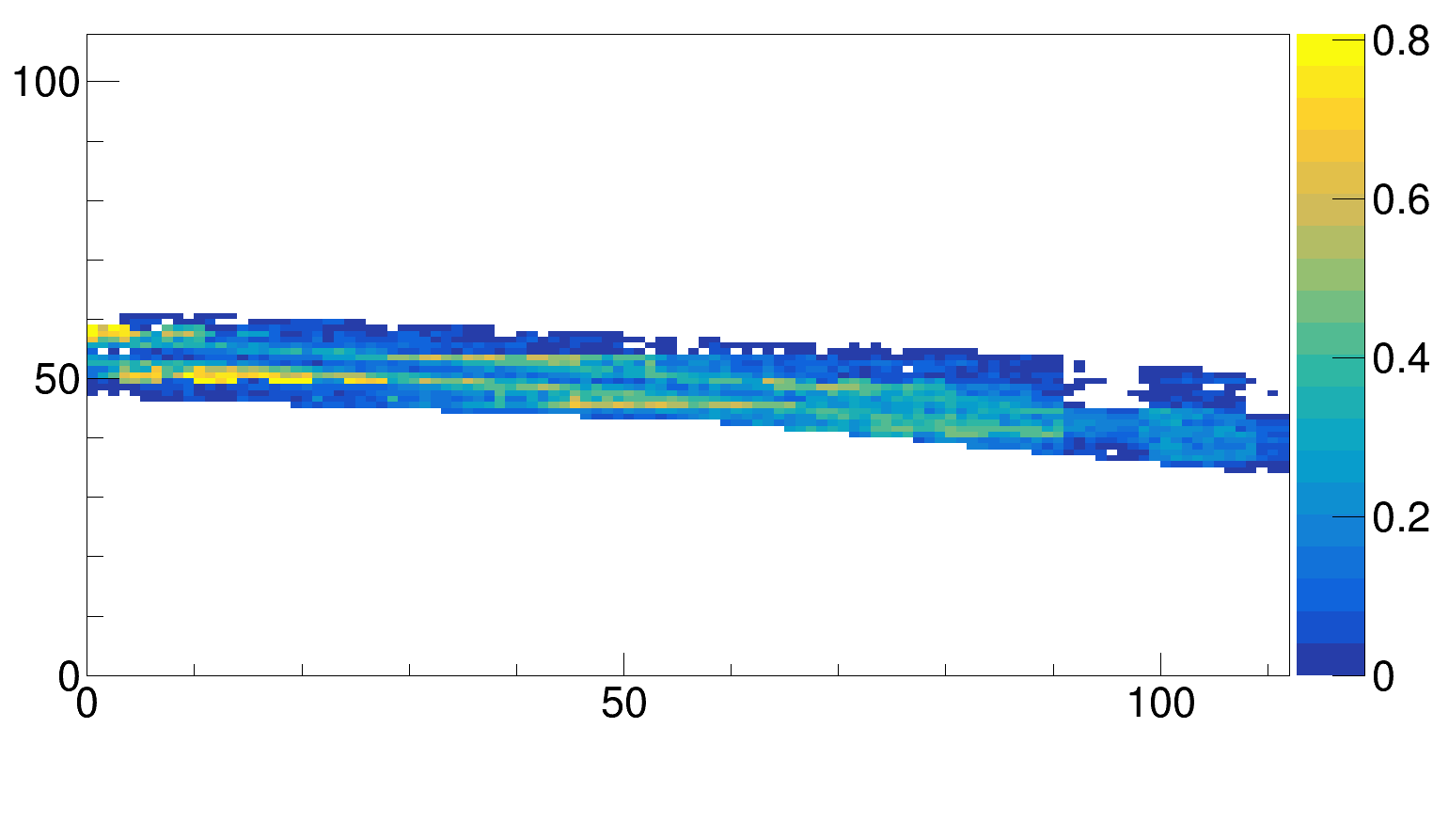
The distribution looks weird, but let’s try it out…
Row
Layer

Slide 28
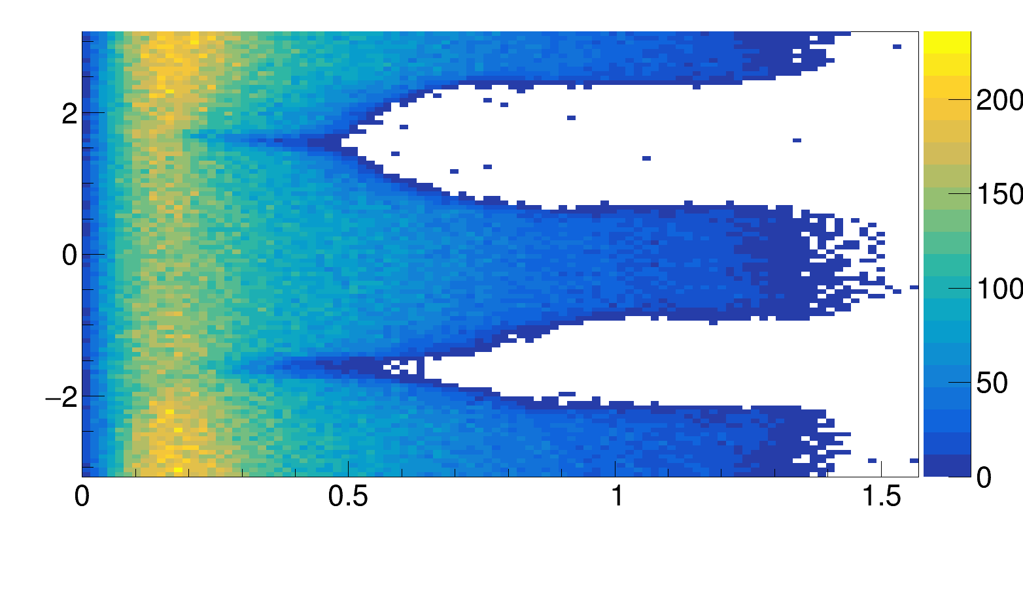
With dead pads on and at beam
Phi (rad)
Theta (rad)

Slide 29
Data
Phi (rad)
Perfect
Theta (rad)

Slide 30
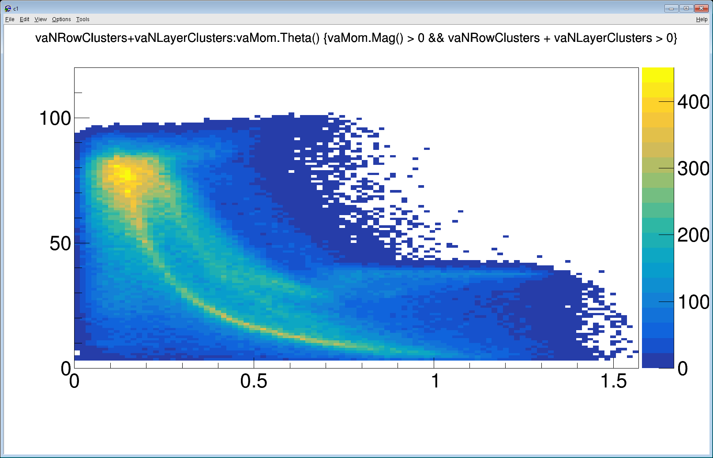
Original

Slide 31
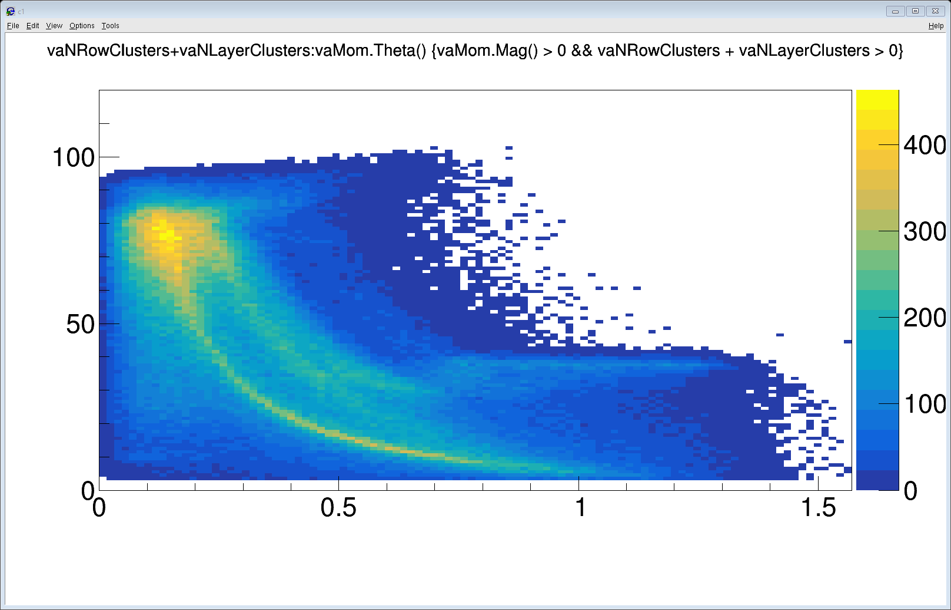
No dead pads

Slide 32
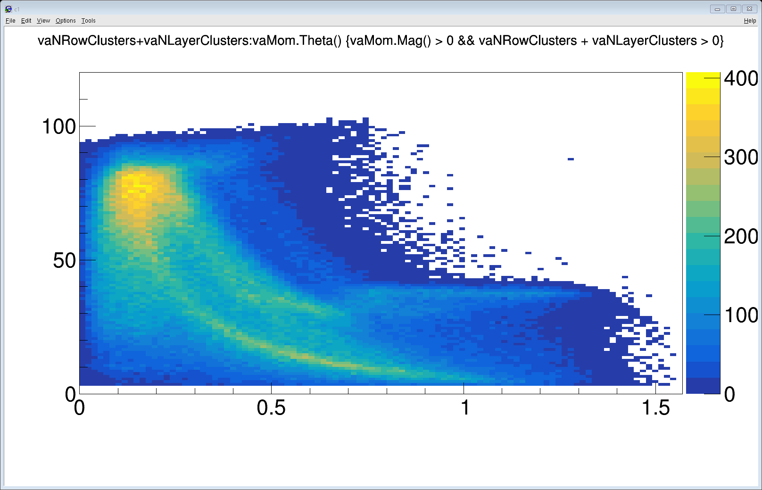
With dead pads

Slide 33
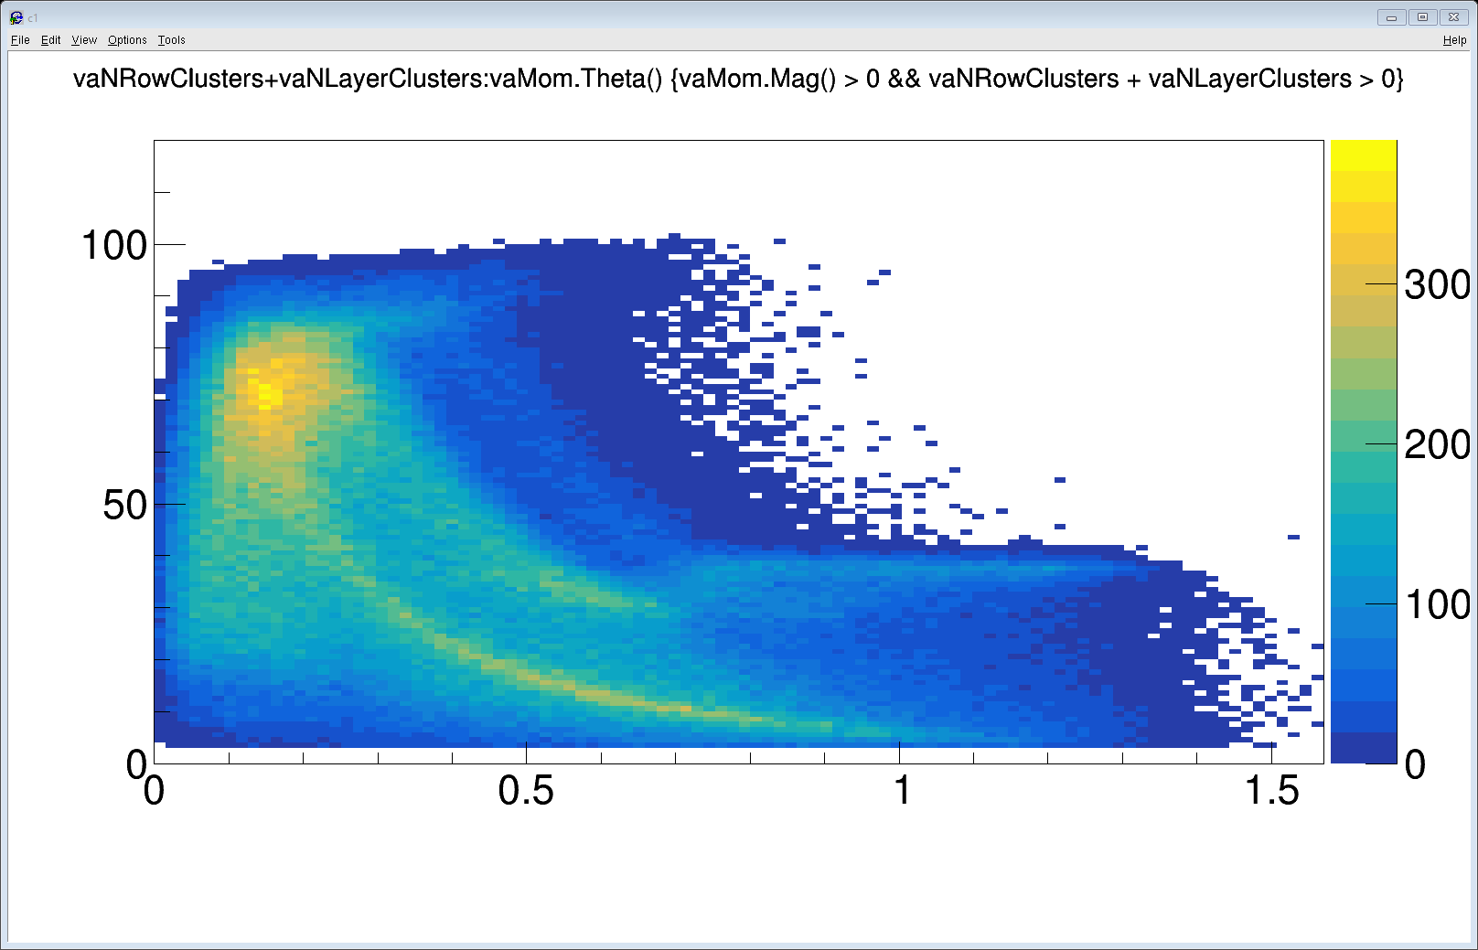
With dead pads on and at beam

Slide 34
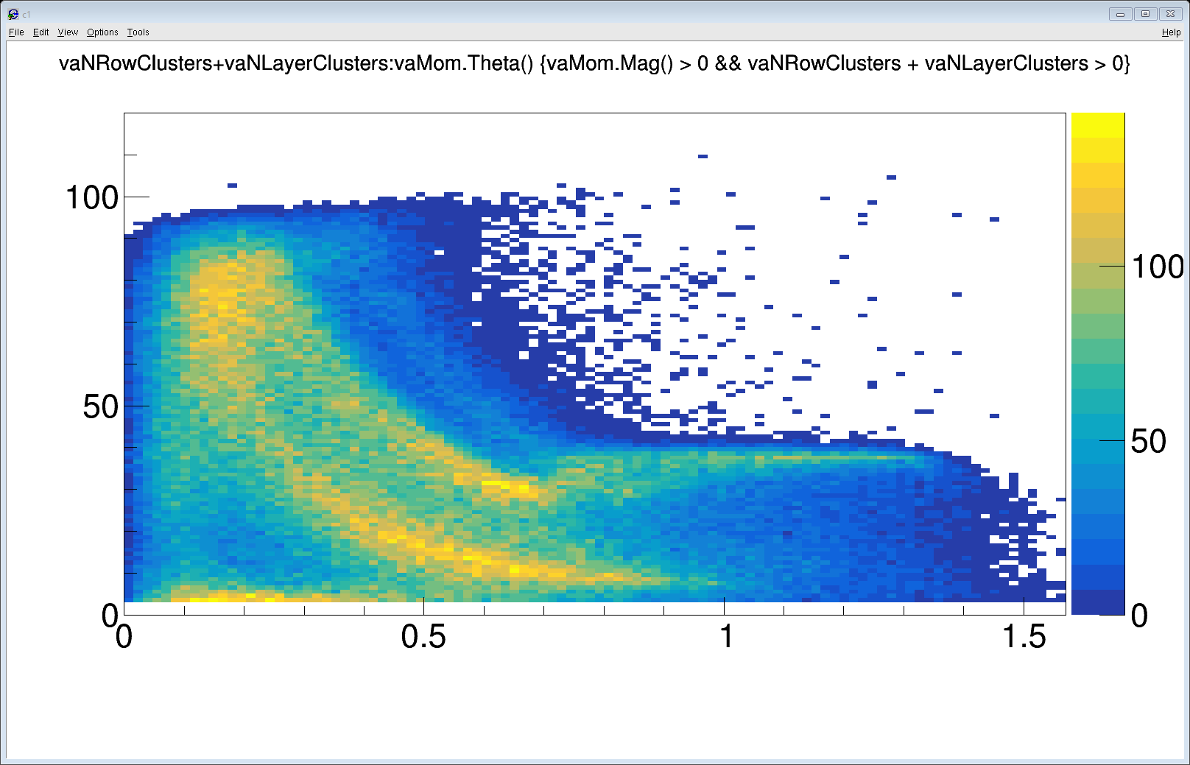
Data

Slide 35
Conclusion
MC tracks reality check: How to proof the tracks that we produce is same with the data?
Ratio of cluster number: continuality, cluster lost rate, noise( background ) level. (In agreement)
Residual error. (In agreement)
Number of clusters in low gain region (In agreement)
Shape of PID (In agreement)
Distance to the vertex. (! Need attention. Y-distribution is still off)
Cluster size. (In agreement)
Embed some real track, compare with the MC track. (Has not been done)
Angular distribution (In agreement)

